Slide 1
Intelligent Chatbot using Deep Learning
Presented by
Anjana Tiha

Slide 2
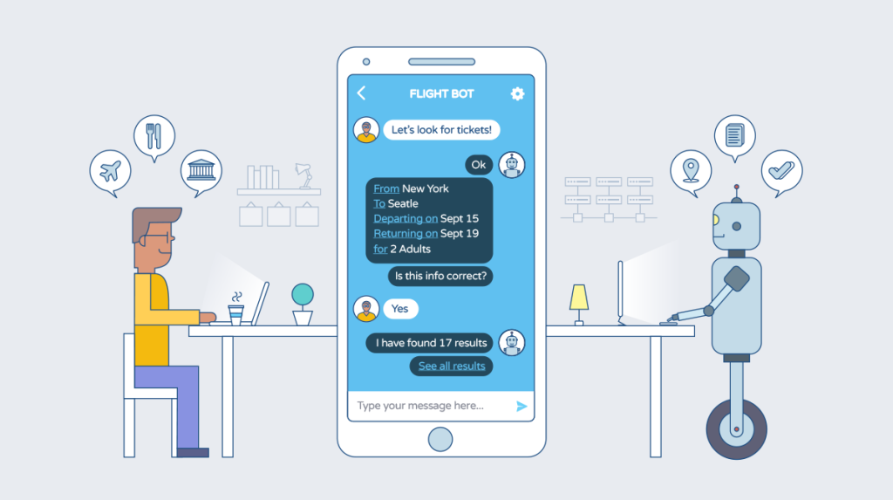

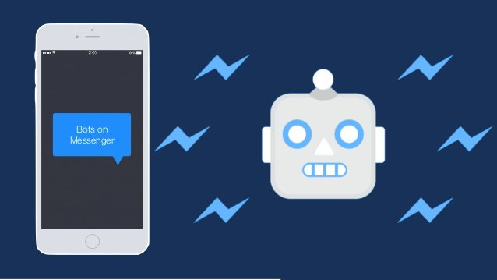
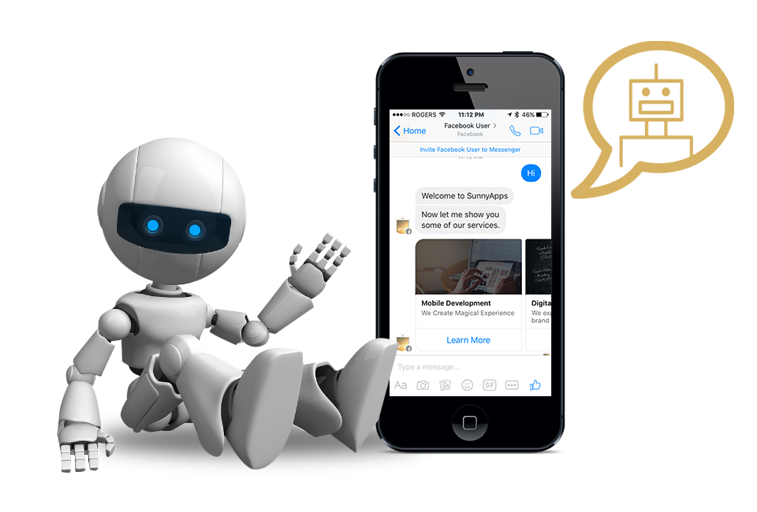



Slide 3
Application
Weather
Helps find out whether one should bring the umbrella before one leave for work.
Personal Finance Assistance
Provide notifications about stock market trends, tracks personal finances, help finding a mortgage.
Bank chatbots let users check on personal account (current balance and recent transactions).
Tax bots that help track your business and deductible expenses.
Product Suggestions
H&M’s Kik chatbot build outfit based on pieces of clothing one have.
Customer Support
AirBnB, Evernote, and Spotify have chatbots on Twitter to provide 24/7 customer service.
quickly provide answers and address customer complaints, or track the status of an order.

Slide 4
Application
Order Food
Domino’s chatbot build new pizza and tracks user order all from Facebook Messenger.
Schedule a Meeting
Meekan - slack bot find times in everyone's calendar to schedule meeting.
Search for & Track Flights
Vacation inspiration.
Tracks current flights, wait times, delays.
Search and compare and book flights and hotels based on price and location from Facebook Messenger.

Slide 5
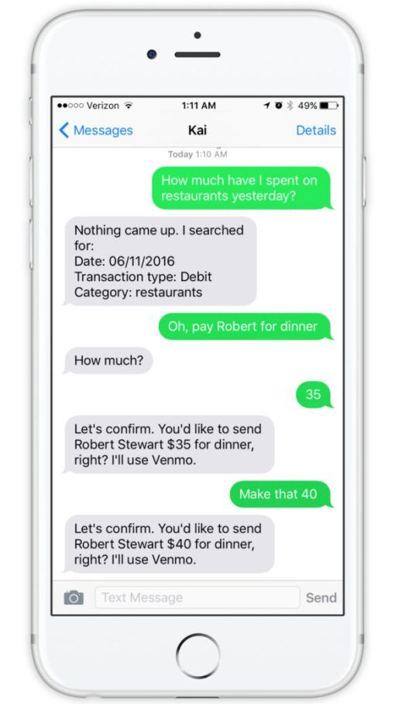
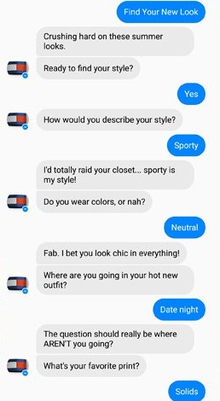
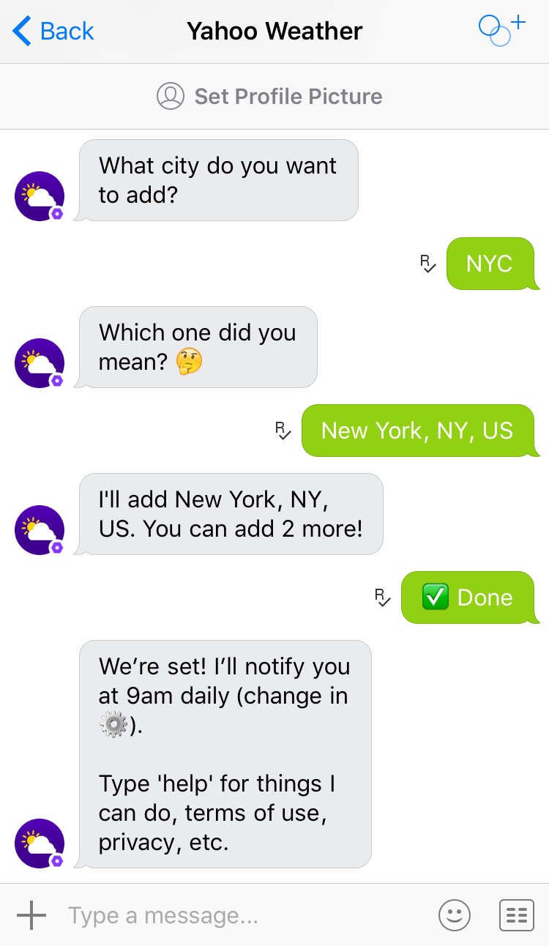
Real Life Example

Slide 6
Why?
Automation of repetitive work
Available 24*7
Provides consistent satisfaction to customers
Helps save money on human resources
Personalized service
Larger engagement capacity

Slide 7
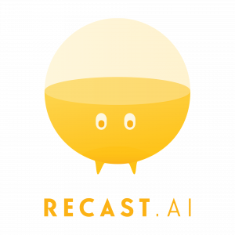



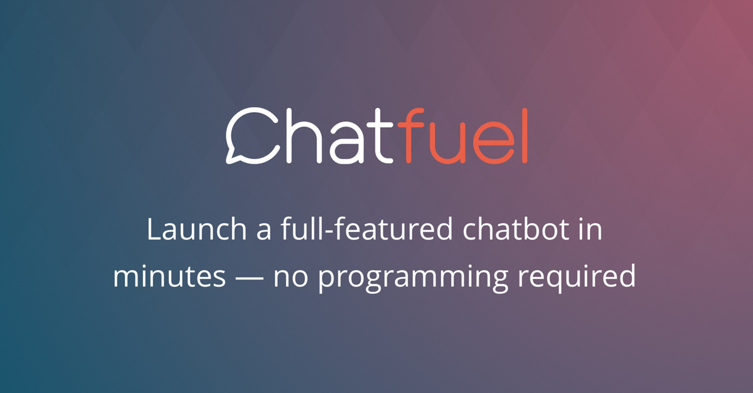
Chatbot Platforms

Slide 8
Virtual Assistant
Amazon’s Alexa
Microsoft’s Cortana
Google's Google assistant

Slide 9
Chatbot Platforms
Morph.ai
Helps in setting up your own chatbot in three easy steps.
Morph.ai uses natural language processing to make conversations more believable.
Motion AI
Visually build, train, and deploy chatbots on FB Messenger, Slack, Smooch, or personal websites.
Microsoft ‘s QnA Maker
Share the URL of your FAQ page
Bot will be created in a few minutes using the information on the FAQ page
Recast.AI | Collaborative Bot Platform
Train, build and run own bot
Converse.io
Integrated into Multiple Platforms
Has own NLP parsing engine.

Slide 10
Code-Based Frameworks
Requires programming languages.
Provide the flexibility to store-data.
Produce analytics and incorporate A.I.
Examples:
Facebook’s Wit.ai
Microsoft bot framework
API.ai
Aspect CXP-NLU
Amazon Lex
IBM Watson Chatbot

Slide 11
Building Framework or Pick One??
Building a framework
Takes time
Framework development is difficult
Needs a team (small)
Planning
Picking a framework
Bending to its rules
Sacrificing some functionality
Sacrificing some interfaces

Slide 12
Limitations
Limited in functionality, domain
works in very structured conversational modes.
works like question answering system.
Ignores context
reduced coherence and relevancy specially for longer dialogues.
Fails to emulate human conversation
generates machine like dialogues and lacks flexibility and variety.
Majority of them are developed using
simple rule based techniques.
simple machine learning algorithms.
lack in complexity and sophistication needed to produce good result.

Slide 13
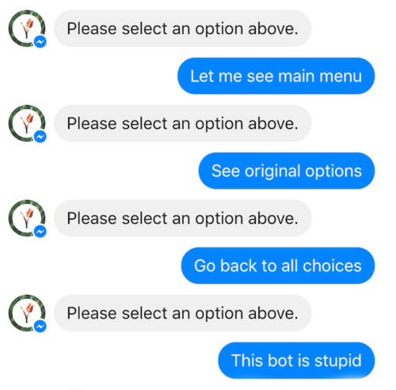
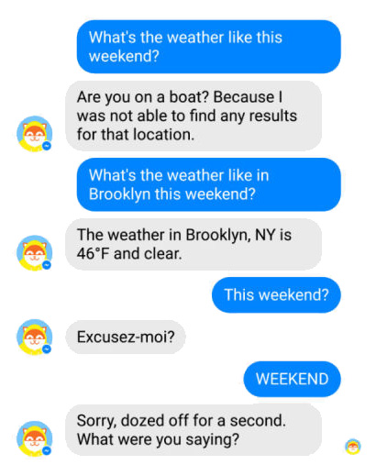
Limitations

Slide 14
Chatbot Development Techniques
Rule based techniques
Machine Learning Algorithms
Natural Language Processing
Deep Neural Network

Slide 15
Deep Neural Network
Convolution Neural Network
Object detection
Image recognition
Text summarization
Recurrent Neural Network
Dialogue generation
Conversation agent/chatbot building
Text classification
Image Captioning
Reinforcement learning
Can improve conversation agent

Slide 16
Google Neural Machine Translation (GNMT)
First introduced in November, 2016.
Translates whole sentences at a time, rather than phrase by phrase processing.
Adaptation of statistical based translation elements.
Supports around 98+ language translation from and to English language.

Slide 17
GNMT Features
Sequence to Sequence encoding decoding architecture
Long-Short-Term-Memory (LSTM)
Bi-directionality
Neural Attention Mechanism
Beam Search

Slide 18
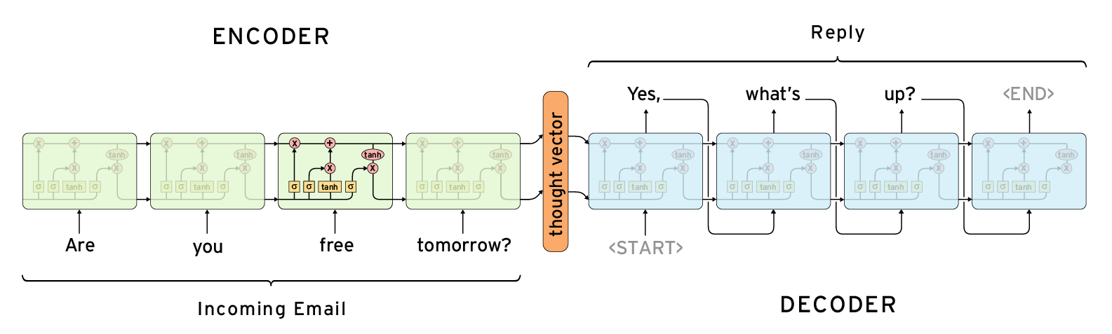
Sequence to Sequence (Seq2Seq)

Slide 19
Recurrent Neural Network
Used for sequential memory
Primarily used in Natural Language Processing
Consists of 3 layers:
Input Layer
Takes input as scaler vector
Applies weight and biases
Hidden Layer
Can have multiple layers
Applies weight
Output is generated using activation function
sigma, tangent
Output Layer

Slide 20
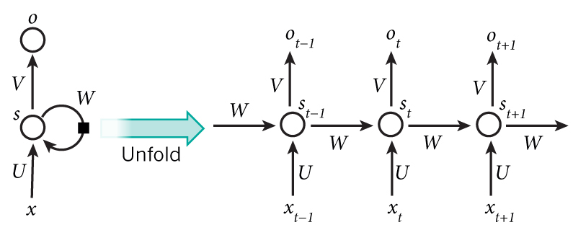
Recurrent Neural Network

Slide 21
Limitation of Recurrent Neural Network
Does not work for most NLP problems.
Too simple architecture to handle complex problems.
Complete sequence may be irrelevant to store.
Sparse tokens in sequence may be relevant.
For long sentence or sequence, RNN may fail and memory may become bottleneck.

Slide 22
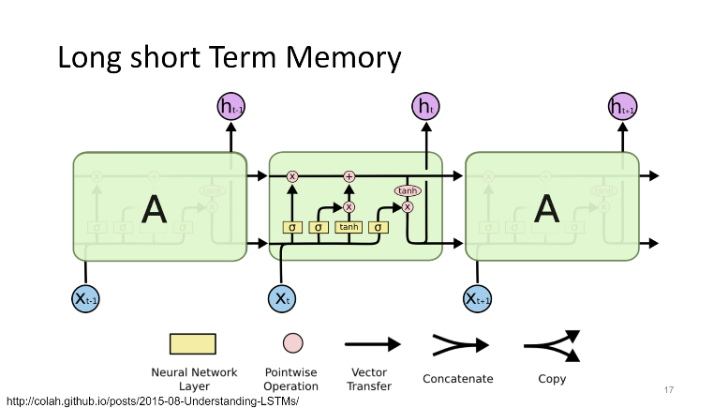
Long-Short-Term-Memory (LSTM)

Slide 23
Long-Short-Term-Memory (LSTM)
Cell unit type for layers of a recurrent neural network (RNN).
Composed of a cell, an input gate, an output gate and a forget gate.
Cell ("memory" in LSTM) remembers values over arbitrary time intervals.
Classify and predict on time series data where time lags of unknown duration between important events occur.
Helps with the exploding and vanishing gradient problem.
Relative insensitivity to gap length
gives an advantage to LSTM over alternative RNNs, hidden Markov models and other sequence learning methods in numerous applications.

Slide 24
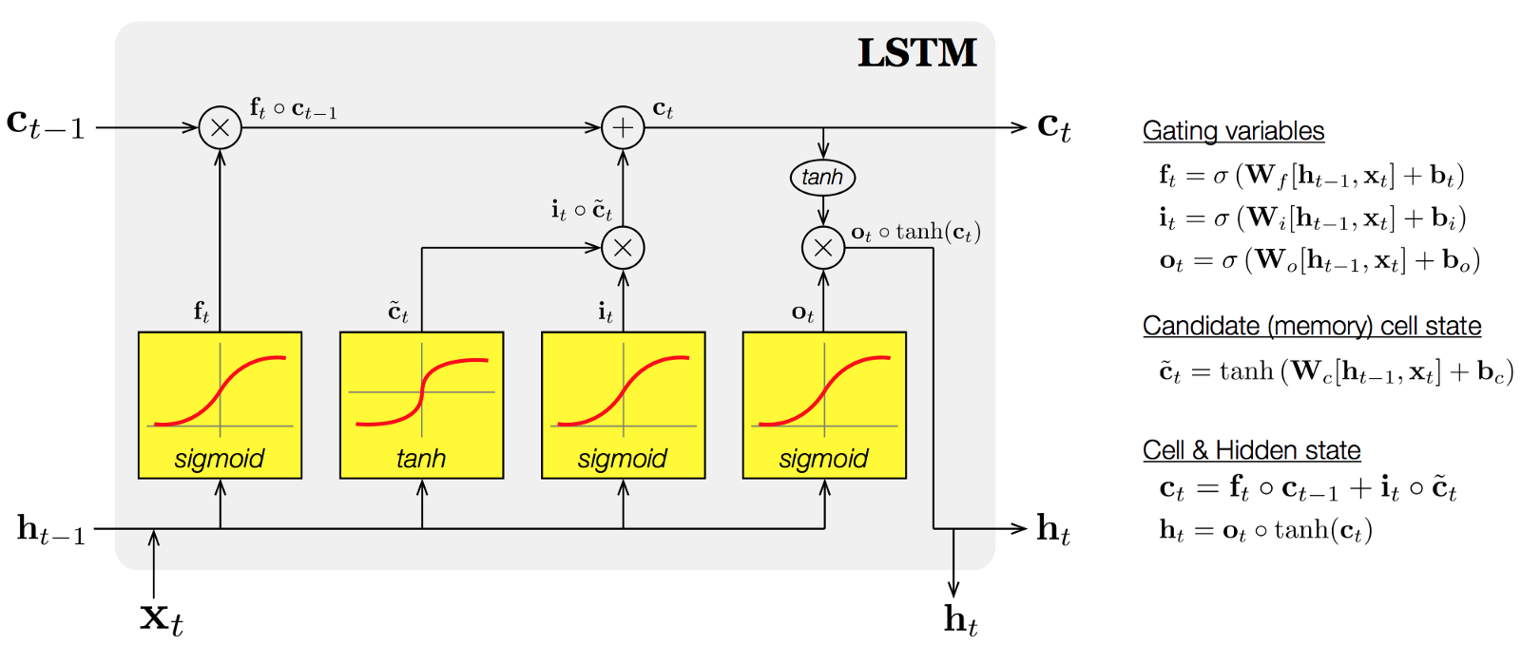
Long-Short-Term-Memory (LSTM)

Slide 25
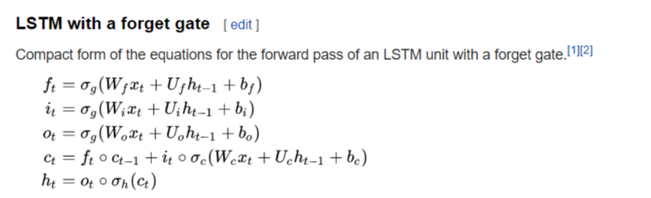
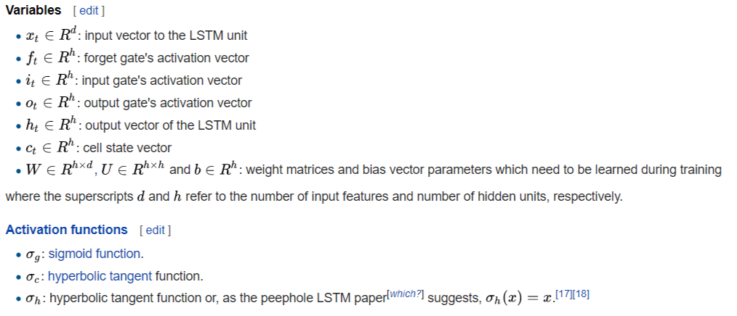
Long-Short-Term-Memory (LSTM)

Slide 26
Neural Attention Mechanism
Standard technique for generative problems
Improves performance significantly
Applications:
Text Summarization
Dialogue Generation

Slide 27
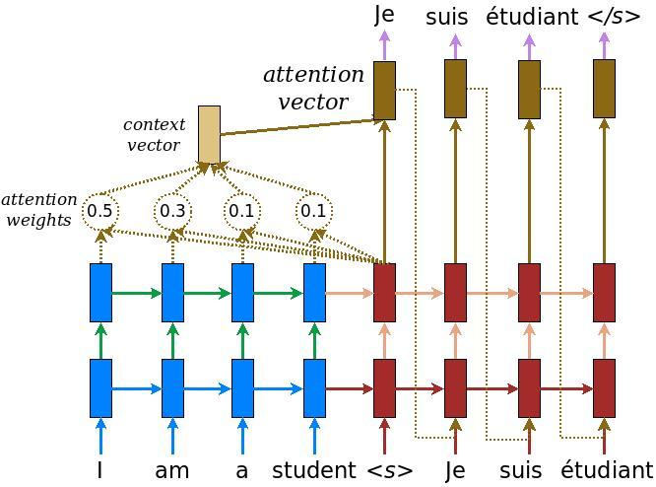
Neural Attention Mechanism

Slide 28
Neural Attention Mechanism
The current target hidden state is compared with all source states to derive attention weights
Based on the attention weights we compute a context vector as the weighted average of the source states.
Combine the context vector with the current target hidden state to yield the final attention vector
The attention vector is fed as an input to the next time step (input feeding).
Source: Reference:1

Slide 29
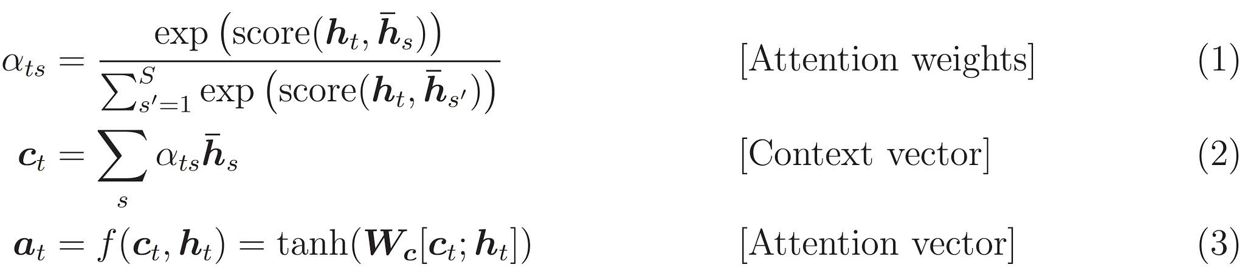
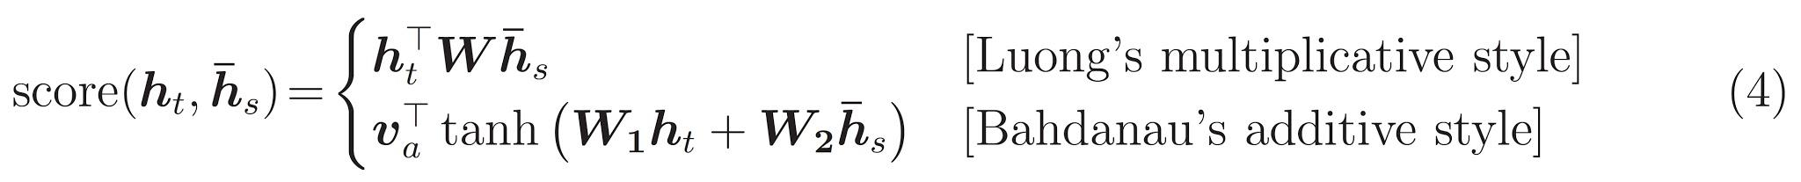
Neural Attention Mechanism
Source: Reference:1

Slide 30
Data Collection
Primary data set "Cornell Movie Subtitle Corpus"
Other dataset processed and trained :
"Open Movie Subtitle Corpus“ and "Movie Subtitle Corpus“
Discarded due to lack of data quality and eliminated from training.
Other possible candidate for dataset:
twitter data, reddit dataset and relay chat engine data corpus.
For future work, more robust and real life conversation based corpus is preferable.

Slide 31
Dataset: Cornell Movie Subtitle Corpus
Metadata-rich large collection of conversations from raw scripts from popular movies.
The following are found in corpus-
220,579 conversational exchanges between 10,292 pairs of movie characters.
9,035 characters from 617 movies.
304,713 utterances.
Other movie meta-data :
genres, release year, IMDB rating, number of IMDB votes
Data Source:
http://www:cs:cornell:edu/~cristian/Cornell Movie-Dialogs Corpus:html.

Slide 32
Preprocessing : Cornell Movie Subtitle Corpus
Data was cleaned to remove meta-data:
Movie ID, Character ID, Line ID.
Data separators("+++++") were eliminated.
Characters unsupported by UTF-8 encoding removed.
Data separated in two different files
source (dialogue) and target (response)
assimilated with the input format of GNMT input pipeline

Slide 33
Source and Target Preprocessing
Both files were cleaned simultaneously.
Everything except alphabetical character, and some punctuation (. , ?!') removed
other symbols and numerical characters hold little meaning in conversation.
Text was converted to lowercase.
Multiple consequent occurrence of punctuations (. , ?!’) was eliminated with single instance
reduces punctuation overload.
All the punctuation except (') was separated with single space before and after
better performance in GNMT module.
All the consequent multiple space was reduced to single space instance.

Slide 34
Preprocessing: Dialogue Elimination
Data was cleaned for removing extraneous dialogues.
Utterance with more than 100 length was discarded initially
for both dialogue and response
with increase of dialogue length, context relevance becomes ambiguous.
Later on full training, full length of dialogues were taken without any elimination.
If multiple consequent utterance from single person was present
everything except the last utterance for the person was kept.

Slide 35
Training, Testing, Validation
Source and target file was splitted for
Training, testing and development/validation set
Saved in files for final input pipeline feed.
For vocabulary generation
Google's Sub-word Neural Machine Translation(NMT) module
Suggested by the Google Tensorfow and Google's Neural Machine Translation module documentation.
Sub-word module was applied only on training files source and target files.

Slide 36
Hardware Specifications
Primary training
Personal Laptop
For complete training
High performance computing cluster of University of Memphis Research
Amazon AWS.
Hardware | Configuration
Local machines (personal laptop) | Processor : 7th Gen Intel Core i5-7300HQ mobile processor. Ram : 8GB. Graphics Card : NVIDIA GTX 1050 graphics.
University HPC Cluster | High Performance Computing platform of University of Memphis Research Cluster.
Cloud Computing Platform | Amazon AWS.

Slide 37
Training Hyper Parameters
Parameter Name | Value
Num of Train Steps | 3200
Steps Per Stats | 100
Num of Units | 512
Num of Layers | 2
Cell Type | LSTM
Encoder type | Bidirectional
Neural Attention | scaled luong
Parameter Name | Value
Optimizer | adam
Learning Rate | 0.001
Decay Steps | 1
Start Decay Step | 1
Beam Width | 10
Dropout | 0.2
Metrics | bleu

Slide 38
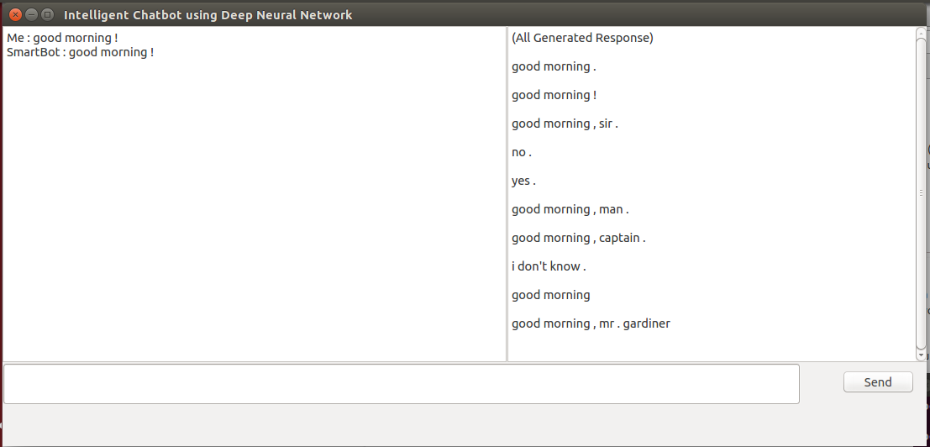
Desktop Graphical Interface (GUI)

Slide 39
Dialogue Generated using GNMT
Input (Person 1) | GNMT Model Output (Person 2 Response)
how are you | how am i?
whats your plan for the weekend ? | i dont know
would you like some tea | would you like some help ?
You got something on your mind | yeah
would you like to go to watch movie ? | no .
where would you like to go for lunch today | i know where to go for lunch today .
i know where to go for lunch today . | you know where to go ?
Where is the library located ? | is that where you were ?
weather seem warm would you like to get some cold drinks | would you like to get some cold coffee ?
did you like the new startrek movie sequel | i did .
band played really well i am going for their next tour | i am going for their next interview .
am i disturbing you ? | no . not at all . where are you ?
i'm heading out . how about you ? | i got to wait for a call .

Slide 40
Evaluation
Dataset | Perplexity | Bleu
eval dev | 50.76 | 10.1
eval test | 46.82 | 10.6

Slide 41
Challenges
Model Specific:
GNMT treated dialogue generation as deterministic translation problem.
Tuning:
Finding right hyper parameters to optimize the for chat bot or dialogue generation system.
Dataset Specific:
Movie data does not reflect real interaction.
Data quality is not optimum.
Loss of data after cleaning and fewer quality utterance
Many utterance was discarded due to longer length or discrepancy in earlier training.
Number of training utterance was less than required.
Dataset was splitted for training, testing and development.
Test and development dataset was quite larger in comparison to training.
Processing:
Training is a long process demands higher processing power

Slide 42
Discussion
Developing chatbot algorithm from scratch would be better
GNMT is primarily for machine translation.
Requires multiple trial and error before reaching optimal performance for the comprehensive chatbot module.
Better suited as research problem.

Slide 43
Questions?

Slide 44
Thank You

Slide 45
Limitations of Seq2Seq Model
Modeling the future direction of a dialogue is crucial to generating coherent, interesting dialogues.
Seq2Seq predicts utterances one at a time while ignoring their influence on future outcomes.
Seq2Seq models tend to generate highly generic responses regardless of the input
Eg. “I don’t know”
Due to high frequency of generic responses found in the training set
Their compatibility with a diverse range of conversational contexts.
System stuck in an infinite loop of repetitive responses.
Due to MLE-based SEQ2SEQ models’ inability to account for repetition.

Slide 46
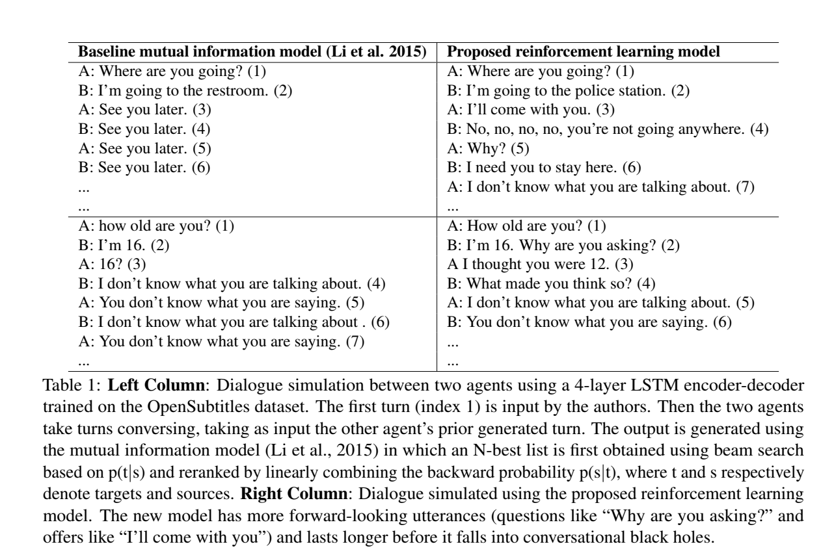
Example

Slide 47
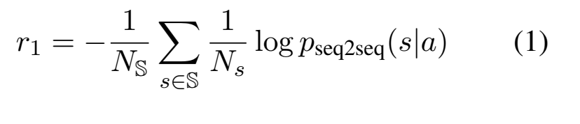
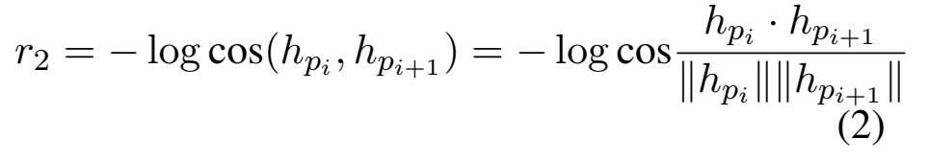
Reward
r denotes the reward obtained for each action.
Ease of answering
Manually constructed a list of dull responses S consisting 8 turns.
“I don’t know what you are talking about”, “I have no idea”, etc.
Information Flow
Each agent contribute new information at each turn.
Penalizes semantic similarity between consecutive turns from the same agent.

Slide 48
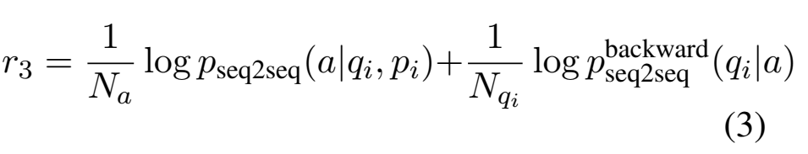
Reward
Semantic Coherence
Penalize ungrammatical or non coherent sentences.
mutual information between the action a and previous turns in the history.

Slide 49
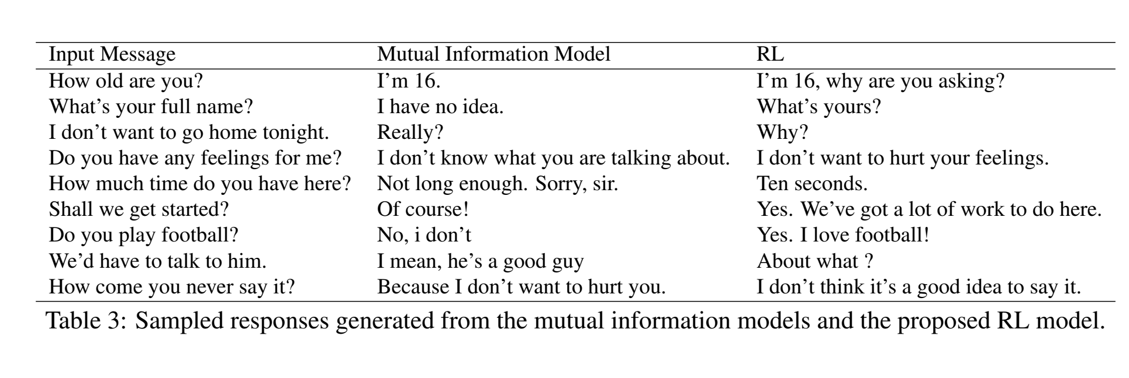
Dialogue Simulation

Slide 50
DRL Discussion
RL model is not optimized to predict the next utterance.
Increase long-term reward.
The RL system produces responses that are significantly easier to answer than does the mutual information system.
RL model has a tendency to end a sentence with another question and hand the conversation over to the user.
Dialogue sometimes enters a cycle with length greater than one.
limited amount of conversational history.
Model sometimes starts a less relevant topic during the conversation.
tradeoff between relevance and less repetitiveness.

Slide 51
Reference
Deep reinforcement learning for dialogue generation
Authors: Jiwei Li, Will Monroe, Alan Ritter, Michel Galley, Jianfeng Gao, Dan Jurafsky
https://arxiv.org/pdf/1606.01541.pdf?__hstc=36392319.57feae9086cbe66baa94bf32ef453412.1482451200081.1482451200082.1482451200083.1&__hssc=36392319.1.1482451200084&__hsfp=528229161
Google's Neural machine translation(NMT)
https://github.com/tensorflow/nmt
Neural Machine Translation (seq2seq) Tutorial
https://www.tensorflow.org/tutorials/seq2seq
seq2seq Github Repository
https://github.com/google/seq2seq
Google's seq2seq
https://google.github.io/seq2seq/
Cornell Movie Dialogs Corpus
http://www.cs.cornell.edu/~cristian/Cornell Movie-Dialogs Corpus.html

Slide 52
Content Reference
https://medium.com/the-mission/11-best-uses-of-chatbots-right-now-1c27764b7e62
https://www.marutitech.com/7-reasons-why-business-needs-chatbot/
https://chatbotsmagazine.com/how-to-develop-a-chatbot-from-scratch-62bed1adab8c
https://www.marutitech.com/complete-guide-bot-frameworks/
https://en.wikipedia.org/wiki/Long_short-term_memory

Slide 53
Image Credits
https://regmedia.co.uk/2017/09/21/chatbot.jpg?x=442&y=293&crop=1
https://cognitiveseo.com/blog/wp-content/uploads/2017/06/Is-Chatbot-Marketing-the-future-1024x512.jpg
http://nyintl.net/site/wp-content/uploads/2018/01/robot-customer-service.png
https://cdn.zmescience.com/wp-content/uploads/2015/06/robot.jpg
http://www.netalogue.com/wp-content/uploads/2017/03/chatbot-880x541.png
https://betanews.com/wp-content/uploads/2017/08/chatbot-e1501792996887.jpg
https://www.adityathakker.com/wp-content/uploads/2017/05/Facebook-Messenger-ChatBot-tutorial.jpg
https://cdn-images-1.medium.com/max/1200/1*FYFI4jbAUMqbXxlo6V_lBA.png
http://sunnyapps.co/assets/images/temp/sunnyapps-chatbots-about.png
https://www.liveworld.com/wp-content/uploads/2017/07/Chatbots-in-customer-service_cropped.png
https://cdn-images-1.medium.com/max/1200/1*fNPqCg4vBiCQS1-nFs7gYA.jpeg
https://cdn-images-1.medium.com/max/1600/0*LyfY3Mow9eCYlj7o.

Slide 54
Image Credits - 2
https://www.dailydot.com/wp-content/uploads/0da/df/dominos.jpg
https://bot-hub.com/media/print_screen/Yahoo-Weather/yahooweather__4.jpeg
https://chatfuel.com/images2/og_chatfuel.jpg
https://4.bp.blogspot.com/UWs8Wger9LQ/WQ8Uh05oMzI/AAAAAAAABrc/oFhlMOasZZIxjDZOxmXGEJLBIfTd2VETACLcB/s1600/bottr-for-blogger.jpg
http://static.hackingrevenue.com.s3.amazonaws.com/2016/08/motionai_0.png
https://botlist.co/system/BotList/Bot/logos/000/000/627/medium/recast_ai.png
https://techcrunch.com/wp-content/uploads/2016/09/api.jpg
http://www.dieproduktmacher.com/wp-content/uploads/2017/08/lex-vs-api.png
http://bodhiinfo.com/blog/wp-content/uploads/2016/09/google-apiai.jpg
https://cdn-images-1.medium.com/max/860/1*QoCscxdXl2mkWqL7mGfALA.png

